Slide 1



CORNWALL CENTRAL SCHOOL DISTRICT
CAPITAL PROJECT UPDATE TO THE FACILITIES COMMITTEE
August 18, 2025

Slide 2





Agenda
Review of May 28 Meeting
  BCS Preliminary Findings
  2025 Pre-Referendum – preliminary concepts for MS Kitchen / Cafeteria - Kate’s Cocktail Napkin; MS Drop-off Loop; HS Stadium Restrooms
Today’s Meeting
  2025 Pre-Referendum – revised preliminary concepts :
    MS Kitchen / Cafeteria
    MS Drop-off Loop
    HS Stadium Restrooms
  Next Steps
    Decisions to me made on above
    Establish Budget
    SEQRA Process Update – TPG
  Completed BCS
    Schedule Facilities Committee Review
    Schedule Full BOE Presentation

Slide 3
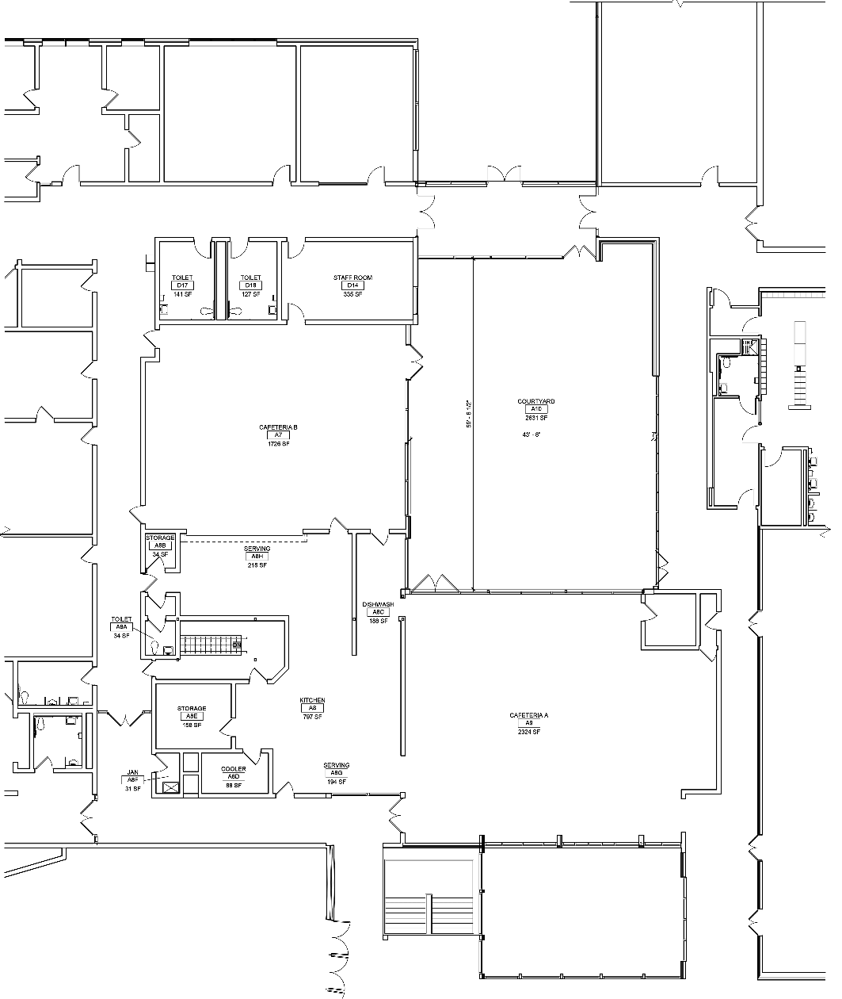
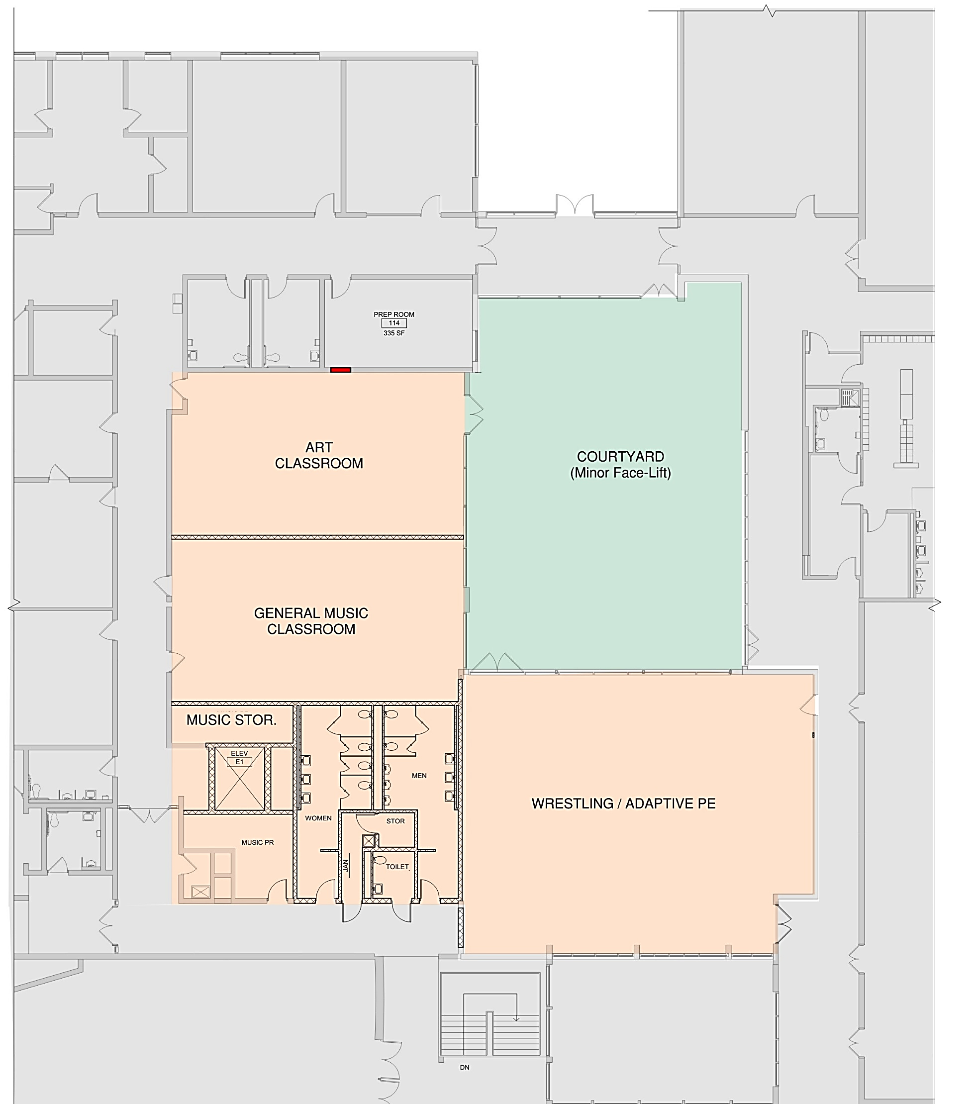
Preliminary Concepts – MS Kitchen / Cafeteria
Existing Plan
Renovated Plan
Color Key:
Existing
Reconstruct
Courtyard Renovation
Courtyard

Slide 4
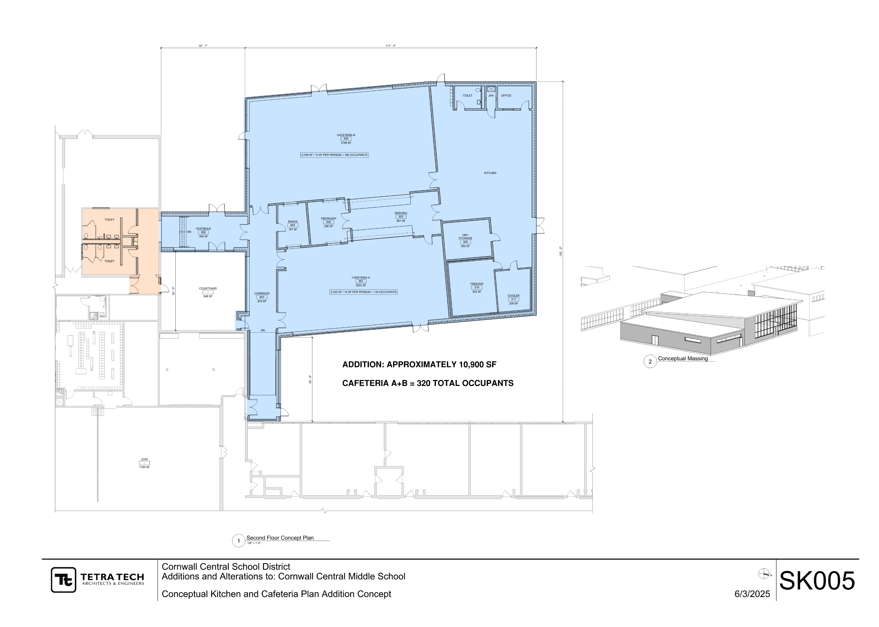

Preliminary Concepts – MS Kitchen / Cafeteria
Addition Plan
111’
32’
Color Key:
Existing
Renovation
Addition
130’
Per SED:
Enrollment of 908 would allow for a cafeteria / kitchen of approximately 4,500 sf. that is eligible to for building aid.
30’
32’

Slide 5
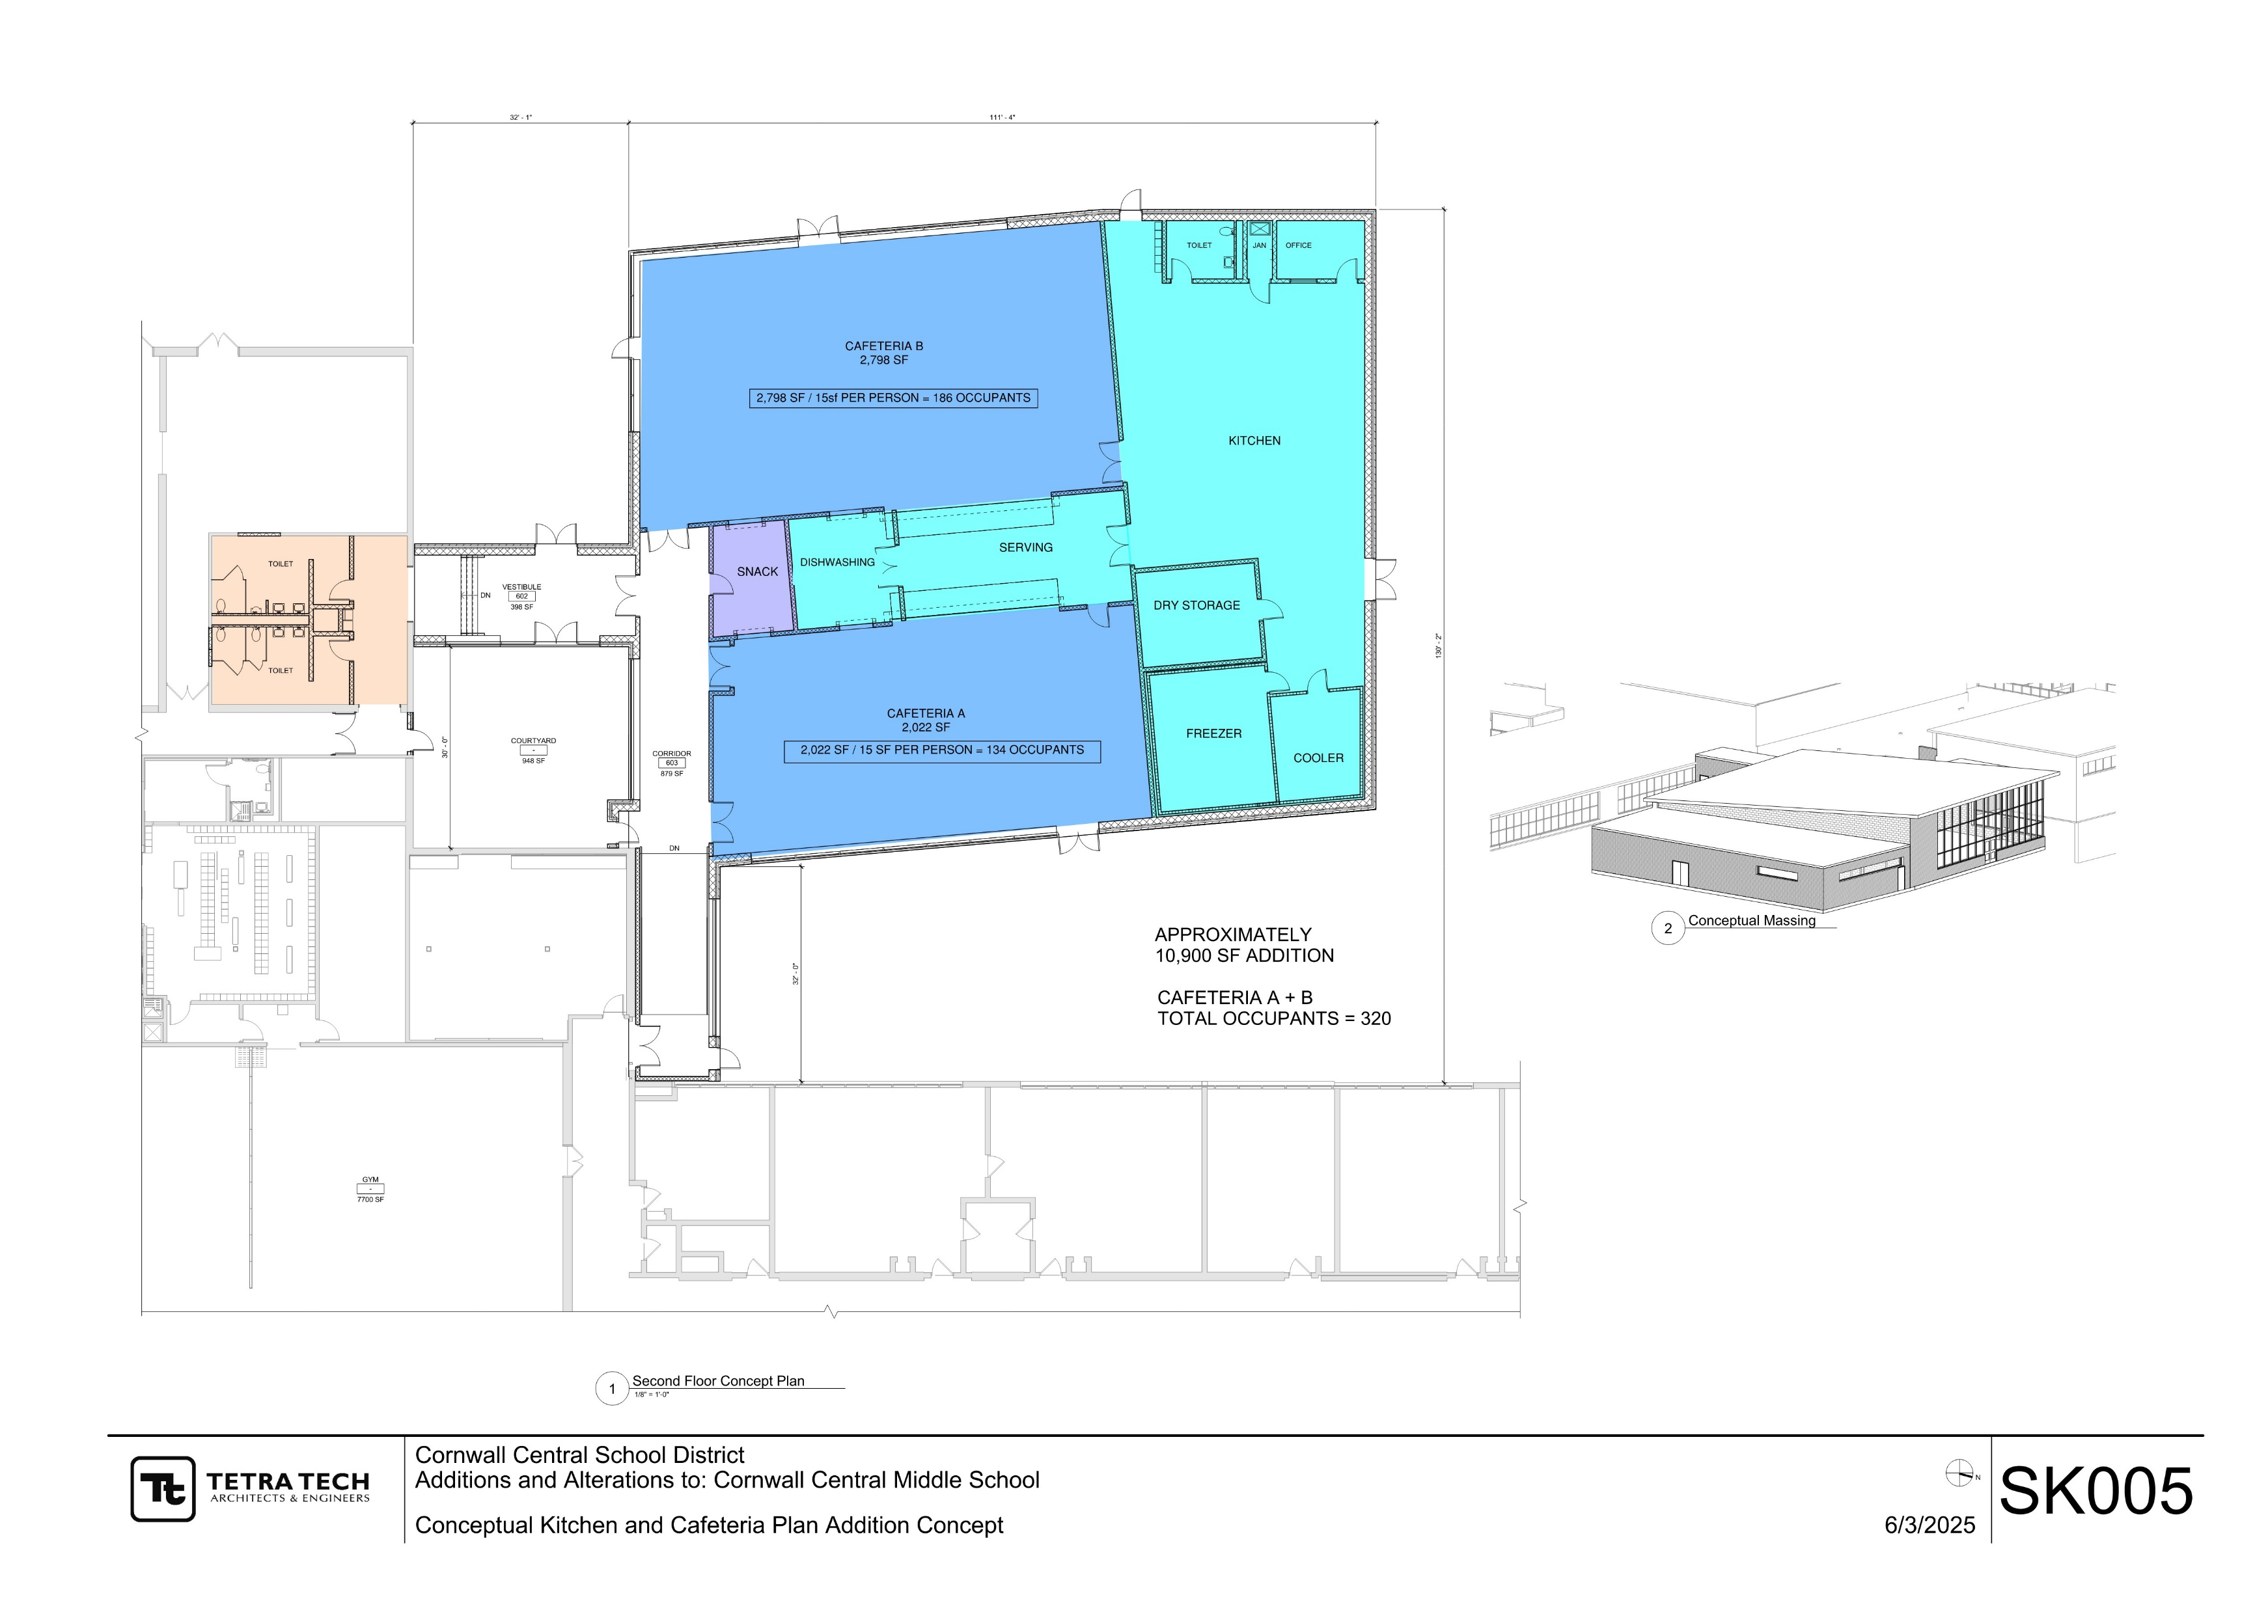
Preliminary Concepts – MS Kitchen / Cafeteria
32’
Addition Plan
111’
Color Key:
Existing
Reconstruction
Kitchen/Serving
Cafeteria A & B
Snack Area
130’
Per SED:
Enrollment of 908 would allow for a cafeteria / kitchen of approximately 4,500 sf. that is eligible to for building aid.
30’
32’

Slide 6
Preliminary Concepts – MS Kitchen / Cafeteria
Color Key:
Existing
Reconstruction
Courtyard
Per SED:
If the old cafeteria is going to be used to create additional instructional space, a full PR and recalculation of existing BAUs will be required.
Existing Renovated Plan

Slide 7
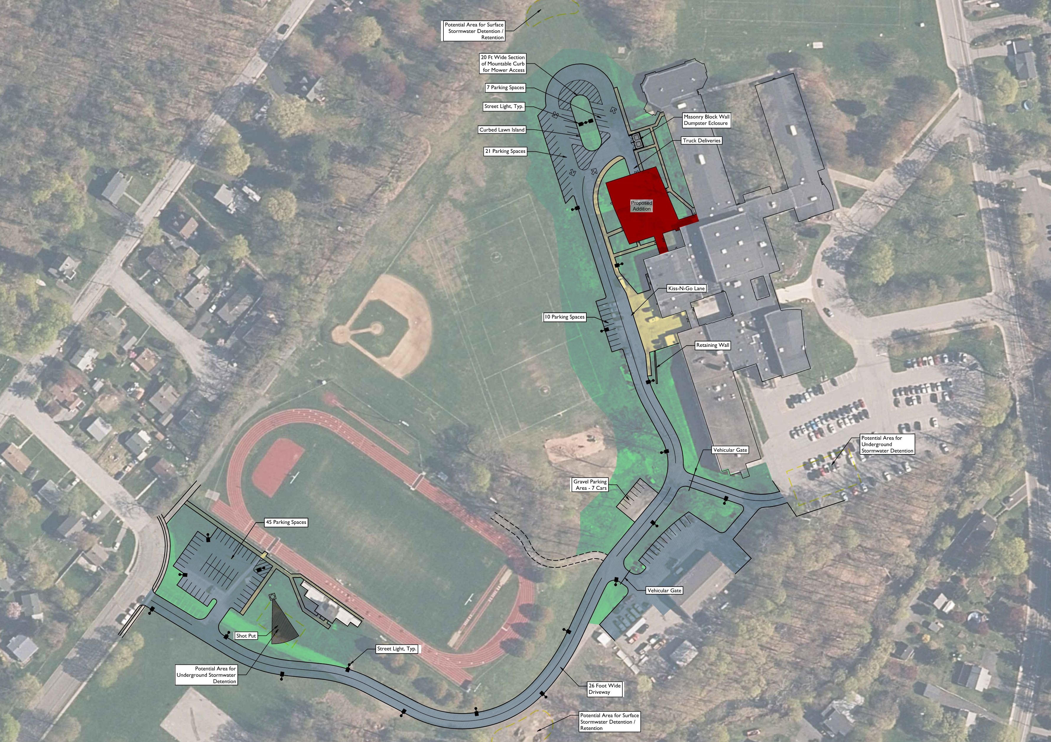
Preliminary Concepts – MS Dropoff Drive

Slide 8
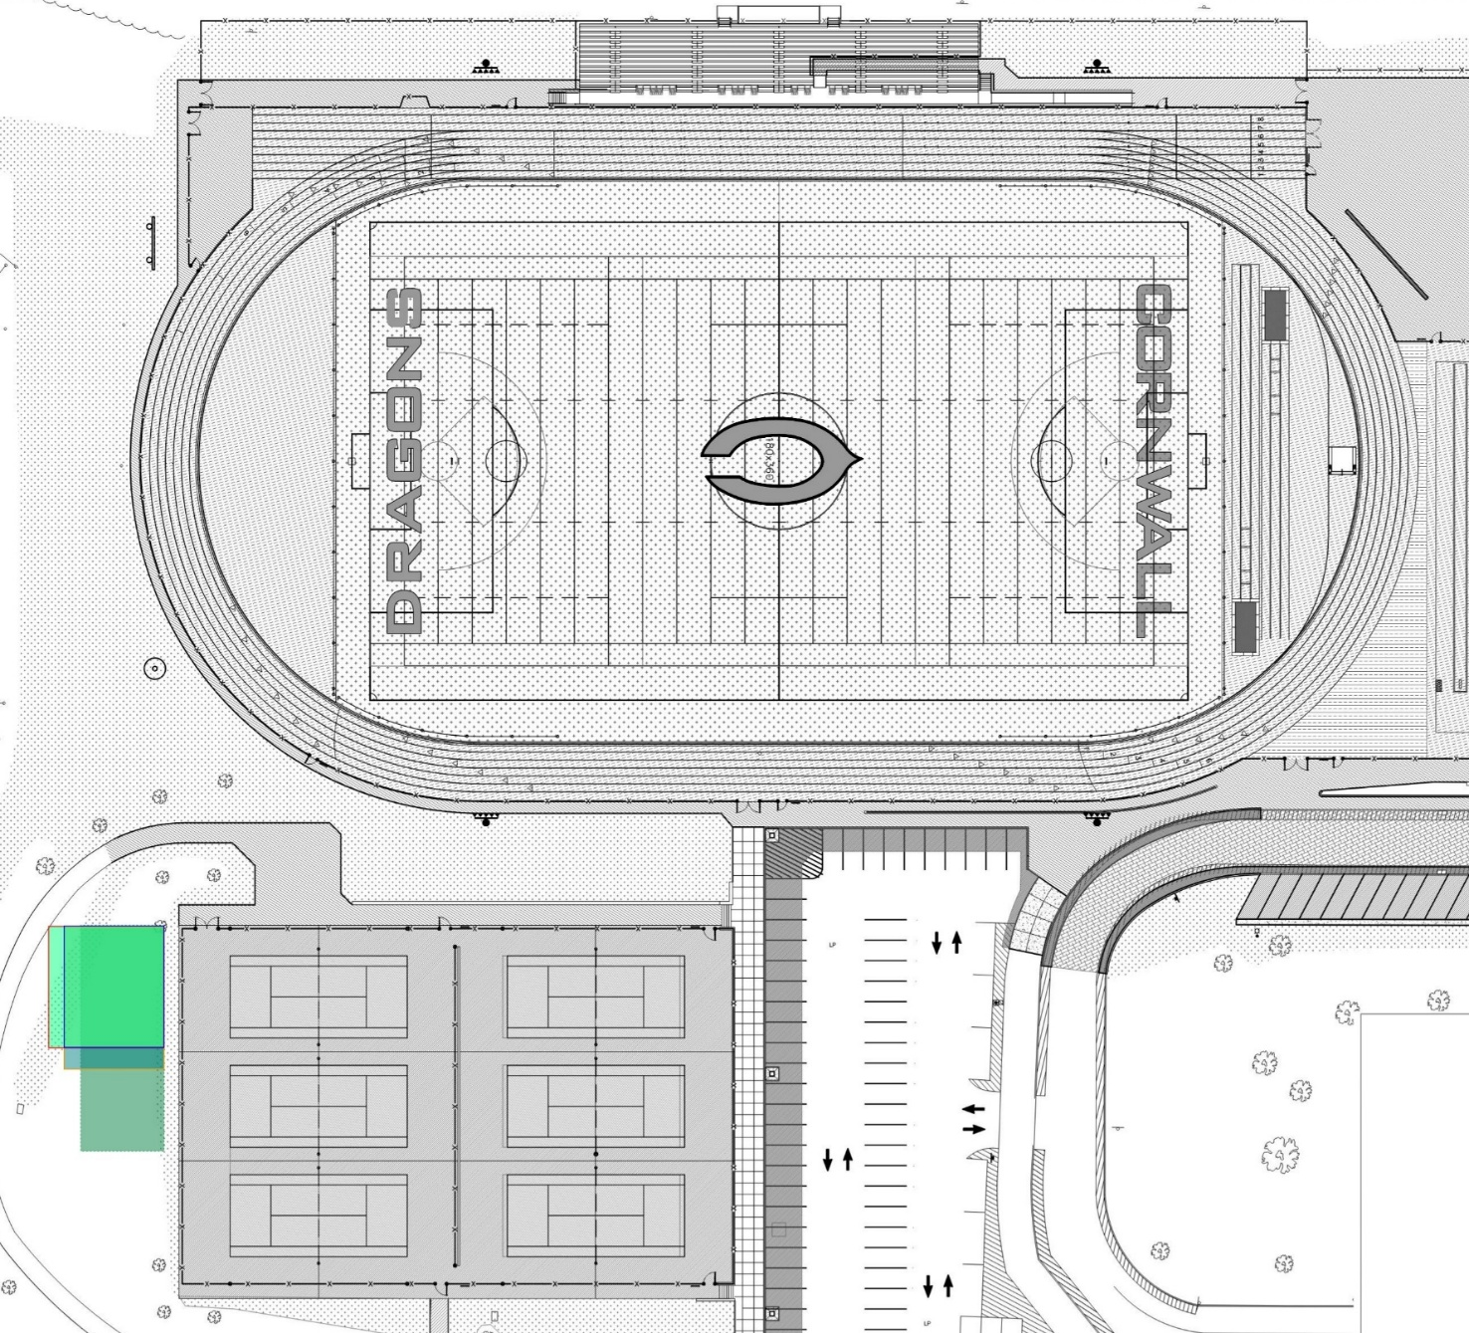
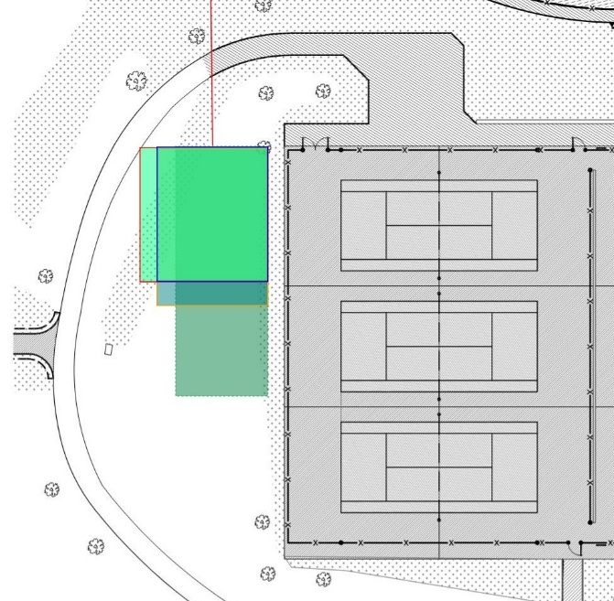
HS Stadium Restrooms
520’

Slide 9
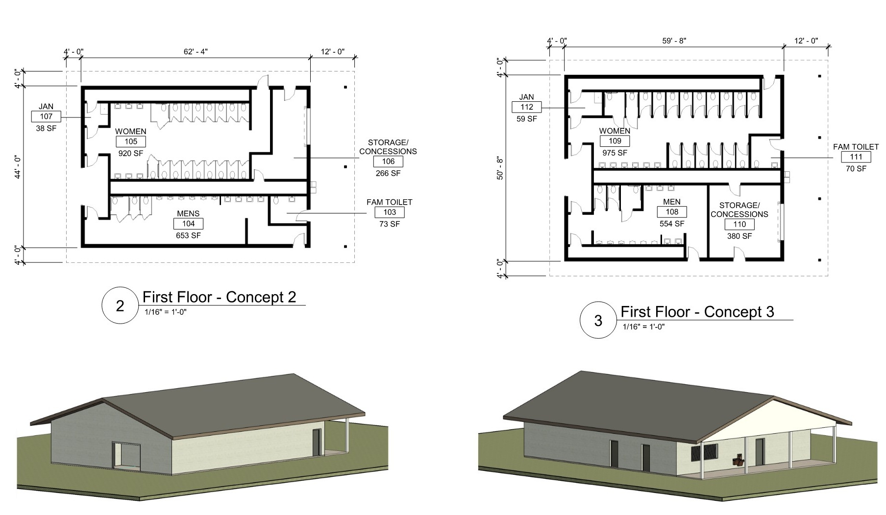
Minimum Fixture
Counts Needed:
Toilets (Water Closets):
  Female: 17
  Male: 9
  Total: 26 *
Sinks (Lavatories):
  Female: 5
  Male: 4
  Total: 9 *
Service Sinks:
  Total: 1
* Min. 5% HC Accessible

Slide 10
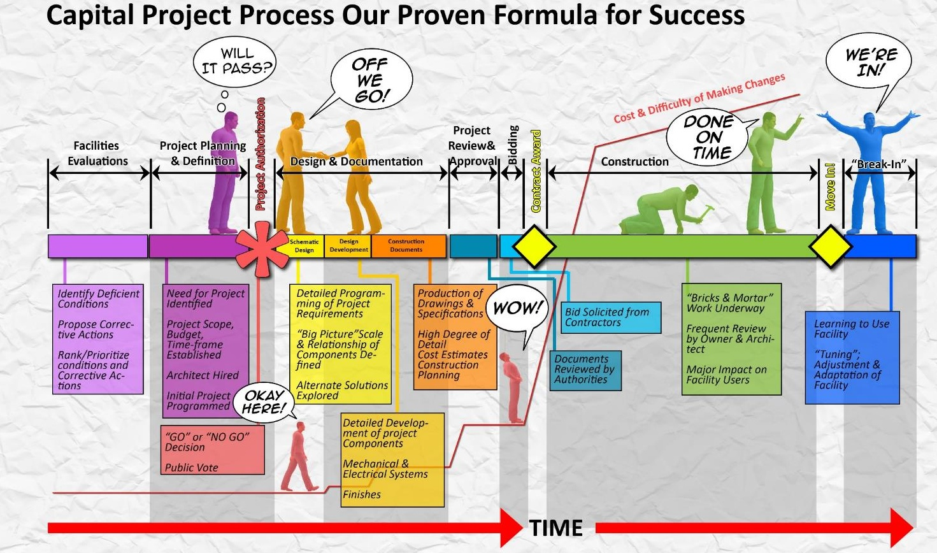
We are here

Slide 11
Preliminary Capital Project Budget

Slide 12

Preliminary Capital Project Timeline
    Based upon voter referendum in Nov./Dec. 2025 and contingent upon confirmation of scope and budgets.
BUILDING CONDITIONS SURVEY
BCS PRELIMINARY HIGH PRIORITY FINDINGS
12/09/25?
12/16/25?
PRE-REF
REFERENDUM
DESIGN
SED REVIEW **
We are here
BID
CONSTRUCTION PHASE / CLOSEOUT
TBD…
    ** SED Review times vary.

Slide 13
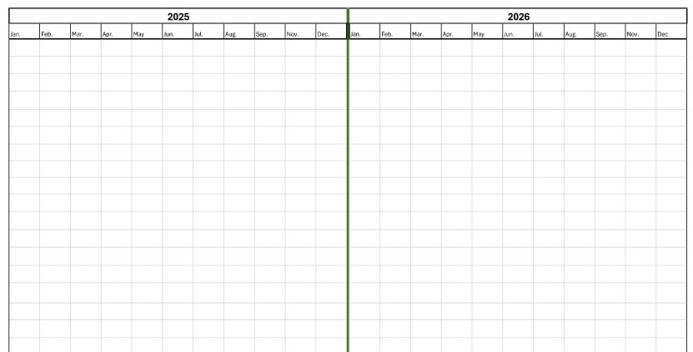

Preliminary Pre-Referendum Timeline
    Based upon voter referendum in Dec. 2025 and contingent upon confirmation of scope and budgets.
Pre-Referendum Phase
Proposition Resolution & SEQRA Determination
Consultant Team Assembled (A/E, CM, Finance, Legal, Bond, SEQRA, Other?)
*
*
*
*
*
*
*
*
*
Facilities Committee and Board of Education Meetings
Stakeholder /
User Group Meetings
Scope Development
Communications & Interpretation
DESIGN
We are here

Slide 14
Pre-Referendum Next Steps…
Establish Overall Project Budget
Scope Development & Pricing
  CCMS Parent Drop-Off/Cafeteria Addition
  CCHS Restroom/Concession
  Other work? (CCHS, CCMS, CES, COH, WAES)
SEQRA Determination/Wetlands
Retain Subconsultants
  Geotech
  Surveyor
  Kitchen?
  Others?
SED Preliminary Submission
Timeline – Referendum Date
Communication Strategy

Slide 15

Questions?
“Children are the World’s most valuable resource and its best hope for the future.”
~John F. Kennedy

